Slide 1
A First-Order Logic with Frames
Adithya Murali, Lucas Peña, Christof Löding, and P. Madhusudan
University of Illinois at Urbana-Champaign and RWTH Aachen

Slide 2
Frame Logic (FL)
Alternative to Separation Logic
Has a Program
Logic based on FL
Similar Design
Principles as SL
Extends
First-Order
Logic:
No * or -*
Captures
Precise Separation Logic
Reducible
to FO
=> Automation!
Notes:
Here are the salient features of Frame Logic, which I will abbreviate as FL
It is, foremost, an alternative to separation logic which I’m calling SL
It is based on similar design principles as Separation Logic, with implicit and ‘local’ or ‘tight’ heaplets. A big application focus of FL is heap manipulating programs, just like SL
It extends first order logic, meaning that it extends the syntax and the usual semantics of FO. In particular it has to separation conjunction * or magic wand like separation logic
Frame logic formulae are reducible to first order formulae. This means that we can use a wide array of existing tools available for FO reasoning to reason automatically about frame logic assertions
In terms of its expressive power with respect to SL, it captures a ‘precise’ fragment of separation logic that has unique heaplets (I will explain this later)
Finally, we also have a full program logic with local and global rules to reason about programs annotated with Frame Logic

Slide 3
Syntax
First-Order Logic with
Recursive Definitions
(FO-RD)
Frame Logic
Example:
where
x points to a list
Notes:
Let’s look at the syntax of frame logic.
First I give you the syntax of multi-sorted first order logic with recursive definitions which I will call FORD for the rest of the talk, which stands for first order logic with recursive definitions
This has formulae with the usual Boolean combinations and quantification, as well as certain symbols that correspond to recursively defined functions.
So in ford you can write formulae like list x and list y, which means that x points to a list and y points to a list
The predicate list itself has a recursive definition interpreted as the least fixpoint
Now, frame logic simply extends ford with a ‘support’ operator Sp. This operator is set-valued, and can be used in the way we use set-valued expressions.
This allows us to write formulae like list x and list y and support of list x and list y do not intersect, which means that x and y point to disjoint lists. This will become clearer when we look at semantics.

Slide 4
Semantics
Sp($α$) =
Set of elements that determine
truth value of $α$
Sp : FL Formula $→$ Set of heap elements
Example 1:
Change pointers outside Sp($α$)
=>
truth value of $α$
remains the same
next
x
y
Notes:
Given that FL extends FORD, we only need to now understand the semantics of the support operator
Intuitively, the support of a formula alpha is the set of elements in the underlying universe that ‘determine’ the truth hood of alpha
In other words, if you changed some pointers or changed the model outside of the support of alpha then the truth of alpha remains the same
Let us look at a simple example. The support of the formula next of x is equal to y is just the singleton set containing x
As you can see from the figure, we only need to know the valuations in the model on x, and we can definitely determine whether next of x is y

Slide 5
Semantics
Sp($α$) =
Set of elements that determine
truth value of $α$
Sp : FL Formula $→$ Set of heap elements
Example 2:
Different from Separation Logic!
$$α$$
$$β$$
Determined support
regardless of truth value
Notes:
Let’s look at a slightly more complex case. The support of the formula alpha ‘and’ beta is simply the union of the supports of the two formulae, as you can see in the figure. Because if the model doesn’t change those parts, we can say that the value of alpha and beta is the same
This is also the case for the formula alpha or beta in our logic. It is the union of the two supports.
Note that this is ‘different’ from separation logic, because we have that the support of the negation of a formula is the same as the support of the formula.
In other words, the support is determined regardless of the truth value of a formula

Slide 6
Semantics
Sp($α$) =
Set of elements that determine
truth value of $α$
Sp : FL Formula $→$ Set of heap elements
Example 3:
heap locations present in the list
x
nil
Notes:
Let us quickly consider another complex example involving the recursively defined predicate list
We expect intuitively that the support of the expression list of x is the set of all the heap locations that are in the list
This is true of the semantics of the support operator

Slide 7
Examples of FL FOrmulae
Example 1: defining a binary tree
Example 2: two lists that may or may not merge (overlaid structures)
Separation logic equivalent:
Hard to express in Separation Logic!
x
nil
y
Notes:
Now that we are familiar with the syntax and semantics of FL, we can look at some examples of frame logic formulae
The first example is that of the definition of a binary tree. It is recursively defined as shown on the slide
It says that nil is a binary tree, otherwise x points to a binary tree if it points to two other nodes left and right, each of which
themselves point to binary trees.
Most importantly, the support or heaplet in separation logic jargon of the two subtrees must not intersect with each other or with the root node x
The support operator is used crucially in expressing the disjointness
A more complex example is that of two lists and may or may not merge, and by merge I mean the kind of intersection shown in the figure. There are just two lists in the heap pointed to by x and y
In frame logic as in first order logic, one can simply say list of x and list of y
However, in separation logic you would have to write a much more complex formula that splits cases on whether x and y indeed merge or not
This quickly becomes even more complex when several data structures are overlaid, and frame logic succeeds here.

Slide 8
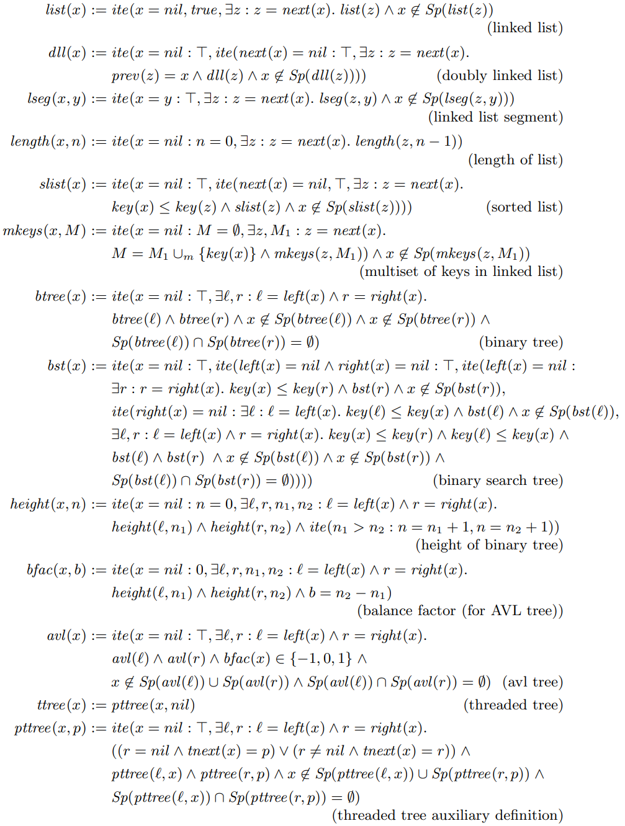
Many more examples in the paper!
Notes:
We have many more such examples of frame logic formulae in the paper. Please check them out.

Slide 9
Frame reasoning
Example:
x
nil
y
If Sp($μ$) is not modified, then the truth value of $μ$
remains the same
Frame Rule:
x
nil
y
Notes:
Ok now we’ve seen some examples and we know what frame logic formulae look like and what they mean
Let us look at how frame reasoning is enabled in frame logic
A simple example that requires frame reasoning is that of x and y that point to two ‘disjoint’ lists, as seen in the top figure
Now if a program modifies the next pointer on x to point to itself, we can see from the bottom figure that x no longer points to a list ending in nil
However, y still points to a list and we would like to conclude that. This is easy because as we can see from the bottom figure that the support of the list pointed to by y is not touched by the program at all. This the frame rule, and so in frame logic we can write the disjointness of the two lists using the support operator and intersection, which enables us to conclude the desired postcondition
This is an instance of a much more general ‘frame rule’ that we describe in the paper. It essentially says that if the support of a formula mu is not modified by the program, you can simply assert it in the precondition and retain the additional assertion in the postcondition
Achieving this is quite nontrivial; Please check out the paper for the formal presentation and proof

Slide 10
Reduction to FO-RD
FL formula + auxiliary predicates $≡$ FO-RD formula
Example 1
Example 2
where
Separation logic has ⁠—* which is not FO
Amenable to automated reasoning using standard tools for FO!
Notes:
I would now like to talk about how one can reason with frame logic formulae.
We have seen that FL extends ford. But we show that FL formulae are reducible to ford formulae
This means that we can simply do the reduction and check our assertions using any number of existing tools that reason about formulae in first order logic with recursive definitions
This is very different from separation logic, which has the magic wand operator whose semantics is not first order expressible. This reduction is a key result of our work
I have shown some examples of what the reduced formulae look like. Recall that support is defined on the structure of the formula, so given this if then else expression in example 1 we can simply apply the definition on the structure of the expression, and eventually end up with an expression that does not have the support operator
Example 2 shows that this idea works for supports of recursively defined functions as well.

Slide 11
Precise Separation Logic
Unique and determined heaplets
Examples
… and many more! (Full fragment in the paper)
Studied distinctly in literature
Notes:
Another way in which we explore the expressiveness of frame logic is by proving that it captures a ‘precise’ fragment of separation logic. What is this fragment?
It contains formulae that have unique and determined heaplets, which is not true of all separation logic formulae.
Such a precise fragment is of special interest in the literature, and is studied distinctly. We can see some examples of formulae in this fragment
The formula x points to y has the unique singleton heaplet containing x
And if then else expression built up of similar atomic formulae also falls within this fragment
We can also have recursively defined predicates list list and binary tree (whose definitions we have seen earlier), and it turns out that those have precise heaplets too!
The paper contains the definition of the fragment

Slide 12
Precise Separation Logic
1)Unique and determined heaplets
Examples
… and many more! (Full fragment in the paper)
2)Semantics preserving FL translation
Notes:
We show that this very expressive fragment can be captured by frame logic.
What that means is that we have a semantics preserving translation. For a precise separation logic formula phi, we can define a frame logic formula FL of phi whose truth value is the same and the support corresponds to the heap of the formula as defined by separation logic

Slide 13
Program Logic
Local Rules Global Rules
Similar to Separation Logic Weakest-Tightest Preconditions
Allows composition of local reasoning Weakest truth; tightest heap
with frame rule
Program correctness reducible to FO-RD!:
Different from Separation Logic ⁠—*
See paper for actual rules and soundness proofs
Notes:
Lastly, we also have a full program logic for a while programming language where the annotations are in frame logic
We have local rules in the same vein as separation logic which allow compositional reasoning of local changes and frame reasoning using the frame rule given here
We also define global rules that define weakest tightest preconditions of programs
The weakest tightest precondition of a formula across a program is the weakest formula in terms of truth (this is the standard weakest pre definition) and its support is the tightest of all possible valid preconditions
Such a weakest tightest pre allows us to reduce reasoning of heap manipulating programs annotated with fl formulae to fl, which is itself reducible to ford as shown earlier. So we can reason about programs using existing tool support for first order logic
The actual definitions are pretty involved; please check out the paper for the formal rules and their correctness proofs

Slide 14
Frame Logic (FL)
Alternative to Separation Logic
Many other logics in this space eg: Region Logic (see paper for comparison)
Has a Program
Logic based on FL
Similar Design
Principles as SL
Extends
First-Order
Logic:
No * or -*
Captures
Precise Separation Logic
Reducible
to FO
=> Automation!
Notes:
In summary, we have frame logic, which is an alternative to separation logic that has tight, local, and implicitly defined supports. It extends first order logic in semantics and is reducible to first order in terms of reasoning, which enables automation.
In terms of Separation logic, it captures a pretty useful and expressive ‘precise’ fragment of separation logic, and also supports reasoning about programs by the use of our program logic
Our work is not the first one in this space: please check out the paper for a discussion about the relation with other such logics like region logic
Thank you

